Slide 1


September 2023
J. A. Laird Elementary School

Slide 2


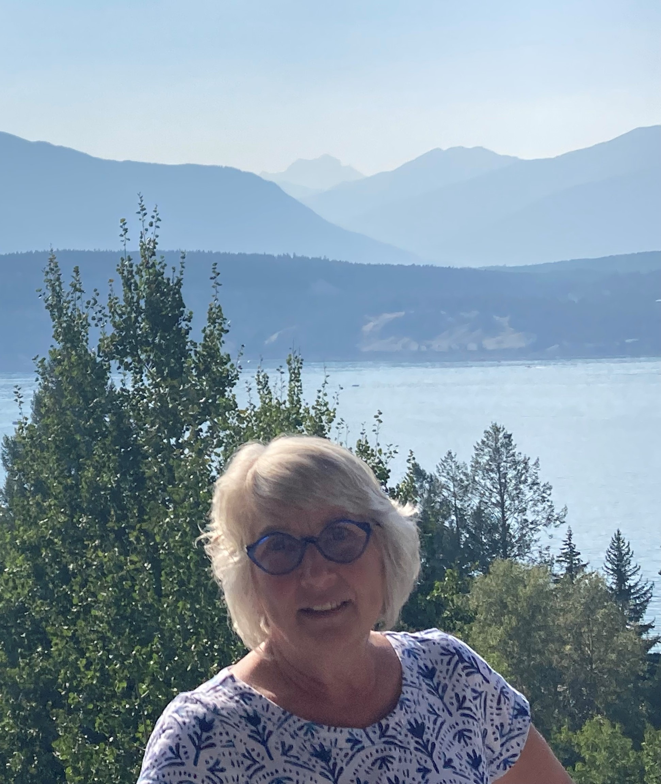

I am pleased to present our School Success Plan goals for the 2023-2024 school year. These goals were developed in collaboration with all school staff and our school community through the May 2023 Community Engagement Evening. At J.A. Laird, we strive for continuous improvement through programs like Leader in Me™, through collaboration with community agencies such as Groundswell Community Network and the Columbia Valley Food Bank, and through building strong relationships with the students and families in our school community.
I invite you to read through our goals, and partner with us as we strive to achieve great things in our work with the young people we are privileged to serve.
<Principal Photo>
Terri Ann Hayes, Principal
J. A. Laird Elementary School

Slide 3
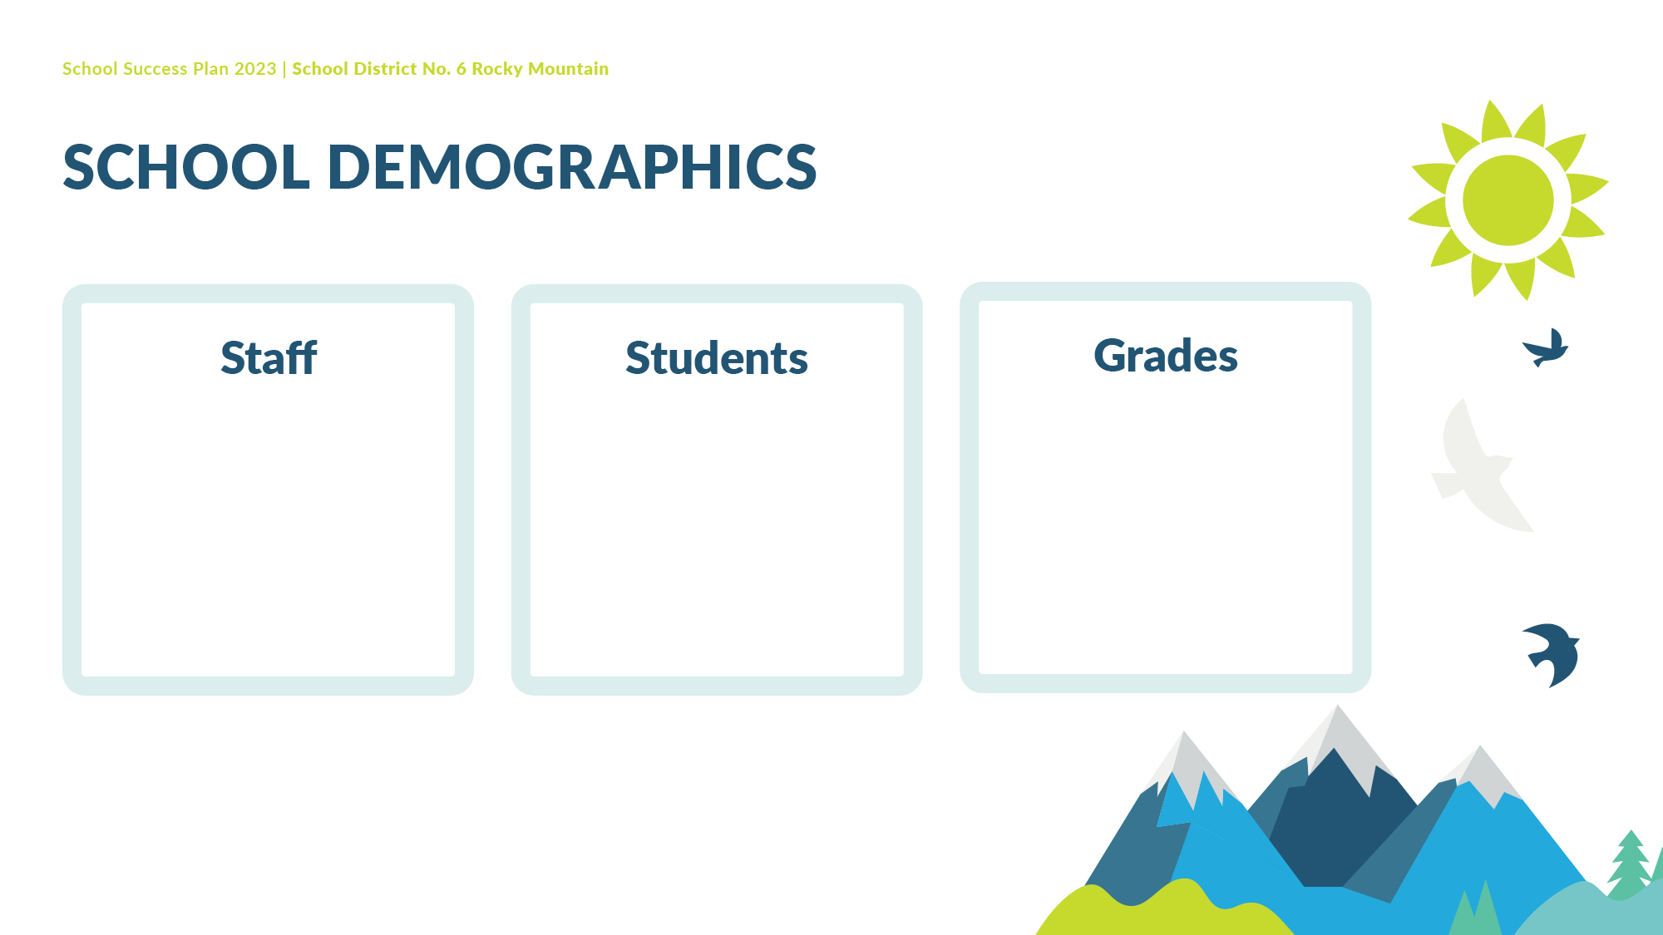
Principal
Vice Principal
Administrative Assistant
13 teachers
7 Education Assistants
1 Indigenous Education Support Worker
1 Youth Care Worker
235
4-7

Slide 4

To support, nurture, and empower each student
Community - We work together to make our school a safe, welcoming and joyful place for everyone.
Caring- We take care of ourselves, each other, our school, our family, our community and the earth.
Diversity, Equity and Inclusion - We value, respect, and support every person in our school community.
Responsibility - We take ownership of our words, our actions, our work habits and our learning.
Limitless potential

Slide 5

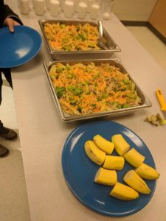
Equity, Diversity, and Inclusion
Improve student access to nutritious food.
<Insert Image>
Leader in Me™ focus:
Sharpen the Saw

Slide 6
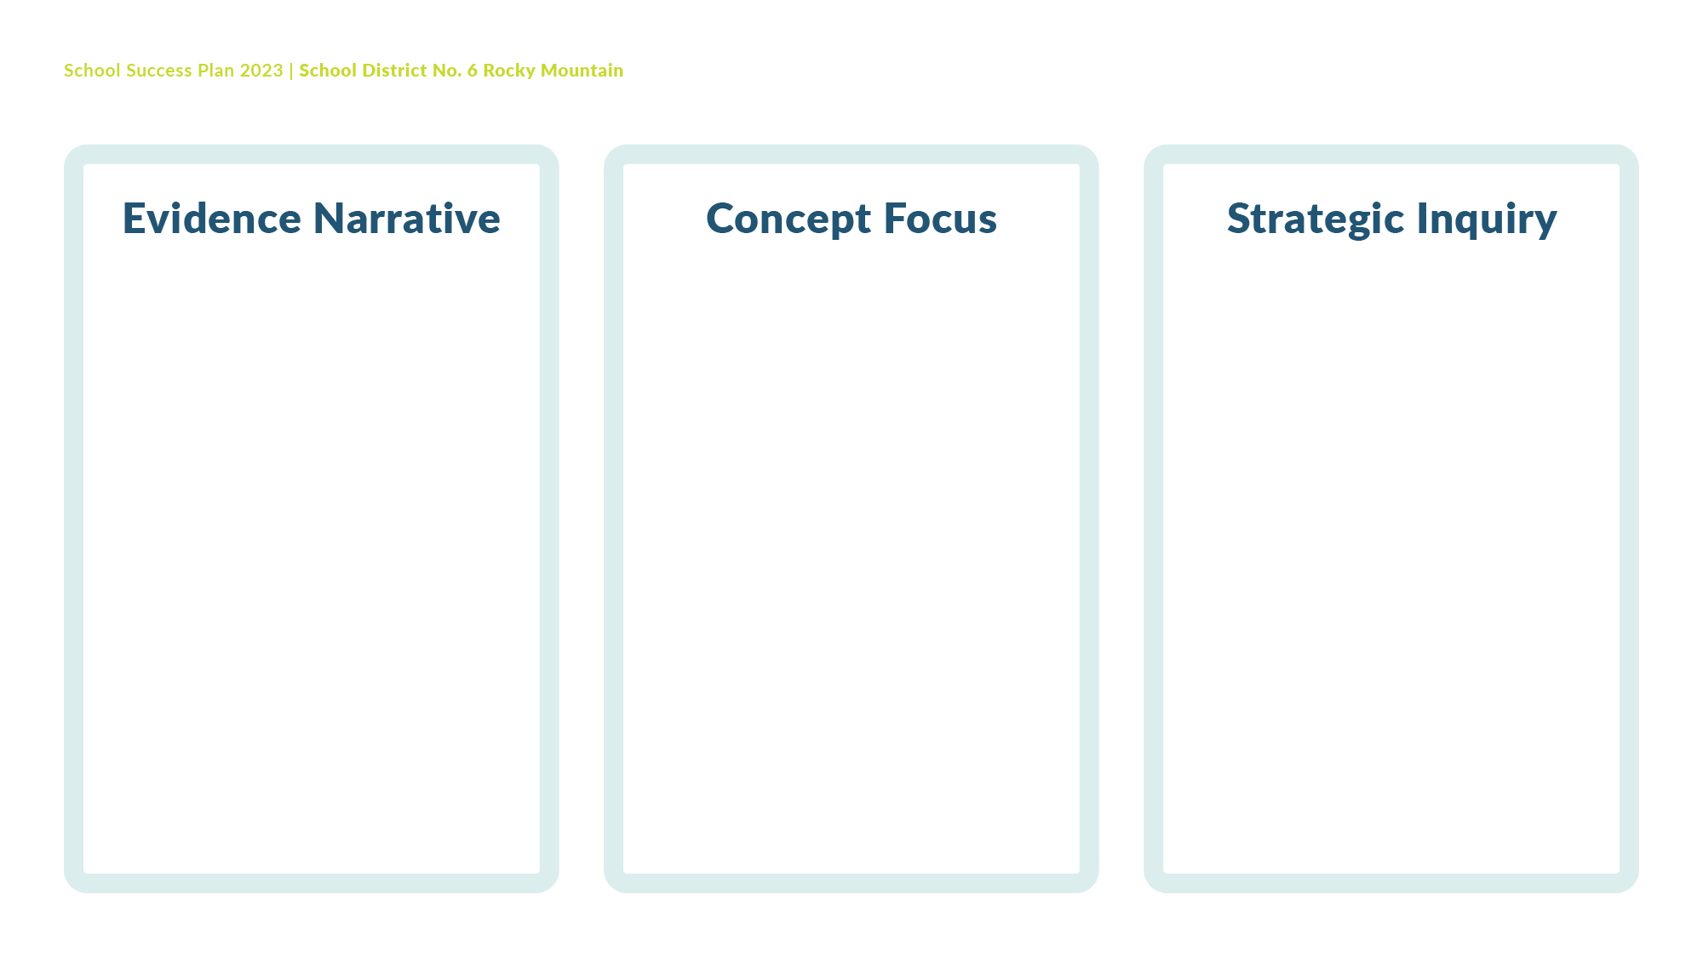
Traditionally, our breakfast program has provided toast and fresh fruit. However, given that a large percentage of our students report not eating breakfast and subsequently feeling hungry at school, we want to be able to provide a wider variety of nutritious foods at our breakfast program to ensure students are ready to learn.
Maslow’s Hierarchy: students’ basic needs must be met before they are ready to learn.
If all staff provide access to a daily, barrier-free nutritious breakfast for students, and ensure that the nutrition curriculum is taught in all classes, will we see a decrease in the number of students who do not eat breakfast, and who report feeling hungry while at school?

Slide 7

Our data clearly indicates that we have a high percentage (approximately 23%, or 55 students) of students who feel hungry while at school, and an even higher percentage of students who do not eat breakfast every day. In all cases, the older a student is, the more liable they are to not eat breakfast and to feel hungry while at school.
Source: Student Learning Survey and Middle Years Development Instrument

Slide 8

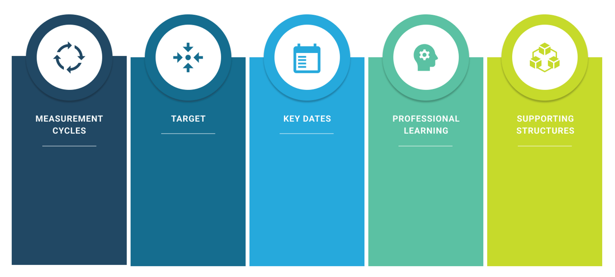
10%
decrease in the number of students who do not eat breakfast.
Our enhanced breakfast program will begin September, 2023. We will re-administer the Student Learning Survey and MDI in March, 2024.
Record daily participation numbers, and re-administer the Student Learning Survey and MDI in March 2024.
Food Safe training for IESW, YCW and Education Assistants.
Feeding Futures funding.
Develop relationships with local food retailers to provide weekly grocery orders. C-Link worker will co-ordinate. Food purchases.

Slide 9

Co-ordinate program with Community Link Worker and District Lead for Feeding Futures initiative;
Ensure Food Safe training for Youth Care Worker and Indigenous Education Support Worker, who will prepare and serve breakfast;
Teachers to sign-up in September 2023 to join students in the breakfast program and provide support 1 day/week;
Purchase of larger refrigerator/freezer for student kitchen;
Investigate funding sources including Ministry of Education and Child Care Feeding Futures funding and other potential grants.

Slide 10

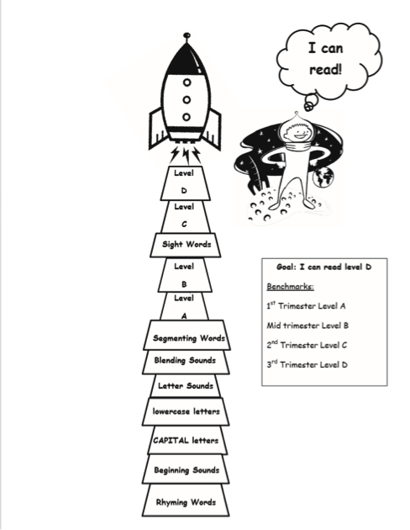
<Insert Image>
Success for Each Learner
Improve numeracy and literacy achievement.
<Insert Image>
Leader in Me™ focus:
Begin with the end in mind

Slide 11
Our last-year’s goal was for students to set a goal prior to reading. However, we noticed that students were often unable to create specific goals related to their learning. We are hoping that by regularly discussing learning intentions and success criteria, students will be better equipped to set specific and achievable learning goals.
Learning Intentions & Success Criteria
If all teachers post learning intentions and success criteria in the classroom and teach students to use success criteria, will students improve in literacy and numeracy?

Slide 12
Our data indicates that a high percentage of students never or almost never set learning goals. In addition, up to 15% of students feel that they do not know what will be considered when marking their work. A recent survey of Core Competency Reflections indicated that only 4% of students were able to set specific, measurable and attainable goals. It is difficult to set specific and achievable goals when students do not know the intention of the lesson, and they are unsure of what success criteria are being used to evaluate progress.
Source: Student Learning Survey

Slide 13
10%
increase in the number of students set specific, measurable and achievable goals for learning based on learning intentions and success criteria.
Spring 2023-administer Student Learning Survey
3X per year
Students will include their Wildly Important Goals in their learning portfolio.
5 staff meetings in the year will be dedicated to learning more about learning intentions and success criteria.
Learning Rounds;
Leader in Me™ goal-setting resources;
Staff Meetings

Slide 14
Dylan Wiliam videos on Learning Intentions viewed at staff meetings and Professional Development days;
Articles by Connie Moss and Susan Brookhart on “learning targets” discussed at staff meetings;
Regular Learning Rounds will be used to observe methods of implementation;

Slide 15

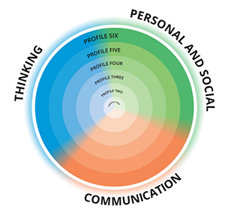
<Insert Image>
Growing Capacity of Self and Others
To improve student self-reflection.
Leader in Me™ focus:
Begin with the end in mind

Slide 16
We know that active participation in the development of learning portfolios leads to greater student self-reflection and meaning-making. Anecdotal evidence from Core Competency reflections suggests that many of our students are not yet able to reflect meaningfully on their growth in thinking; communication; and personal and social competencies.
Learning and Leadership Portfolios
If students routinely select and reflect upon academic and personal/social skills for a personal leadership and learning portfolio, will we see improved ability for students to speak about themselves as learners during student-led conferences and Core Competency reflections?

Slide 17
A random sampling of 100 Core Competency reflections across all grade levels indicates that the majority of children (85%) reflect on the Core Competencies using a single sentence. Furthermore, 47% of reflections were connected to out-of-school pursuits and relationships, as compared to academic accomplishments (12%) or work habits (32%). Our students would benefit from further practice reflecting upon themselves as learners.

Slide 18
100%
of students will create a Leader in Me™ Leadership portfolio
December, 2023; March, 2024; and June, 2024 formal reporting dates
Student-led Conferences;
SeeSaw subscription for every classroom;
Leader in Me™ Leadership Portfolio resources;
Co-created self-reflection rubric
3X/year
Core Competency Reflections included with formal reports
5 staff meetings per year will be dedicated to learning how to support students to create Leader in Me™ and SeeSaw Leadership and Learning Portfolios.

Slide 19
SeeSaw Resources about student learning portfolios will be reviewed during staff meetings and Professional Development days;
Leader in Me™ student portfolio resources will be used to create a Leadership Portfolio for every student;
Teachers will co-create a rubric identifying the criteria for a quality self-reflection;
Students will generate Core Competency self-reflections at least 3 times/year prior to formal reports.

Slide 20

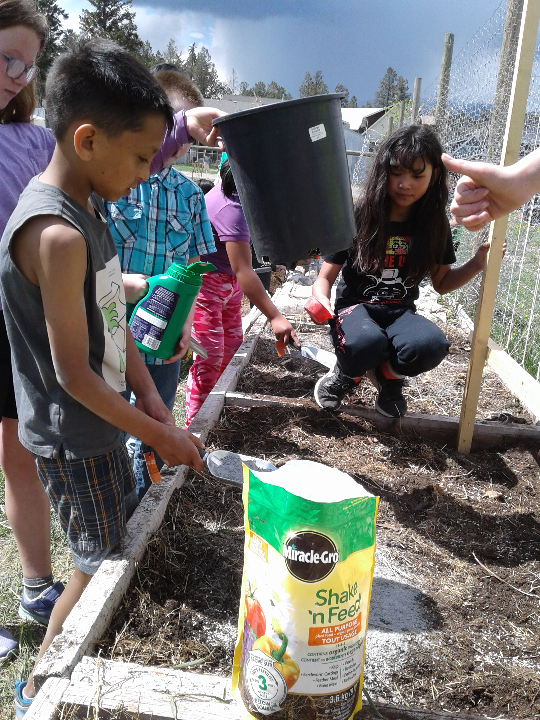
<Insert Image>
Stewardship for the Future
All students will improve their understanding of food sustainability.
<Insert Image>
Leader in Me™ focus:
Sharpen the Saw
Synergize

Slide 21
We have several classes who currently participate in a gardening program, which has taken learning outside more often, and has resulted in students contributing to their community and eating more vegetables. We feel that expanding this program to the entire school will address all of these aspects of learning for more students in the school.
Local, sustainable food production practices.
If teachers teach sustainable food practices, such as gardening, to students, will students develop an improved understanding of global sustainability?

Slide 22
Anecdotally, community members who attended our Community Engagement Session overwhelmingly asked for more opportunities for students to learn outside. Additionally, many students indicate that they do not get to go outside for learning on a regular basis, and that they do not eat fresh vegetables daily.

Slide 23
100%
of students will be able to speak about food sustainability either through their garden journals or SeeSaw posts.
4 staff meetings/year focused on food sustainability.
Autumn 2023 and Spring 2024 gardening seasons
Copy of The School Garden Curriculum: An Integrated K-8 Guide for each teacher;
Soil Study and Inquiry kit for the school
Working relationships with Groundswell Community Network and the Columbia Valley Food Bank;
Staff and grade-team meetings

Slide 24
Collaborative relationship with Groundswell Community Network educators;
The School Garden Curriculum: An Integrated K-8 Guide for each teacher;
Working relationship with the Columbia Valley Food Bank;
Funding potential through PAC, the annual Make It Sow fundraiser, a Whole Kids Foundation grant and Brett Wilson Foundation funding;
Regular grade-team meetings to plan gardening activities and field trips;
Wild Schools workshops on sustainable gardening practices;
Several classes have booked co-teaching sessions with the Columbia Outdoor School around soil health.

